Slide 1
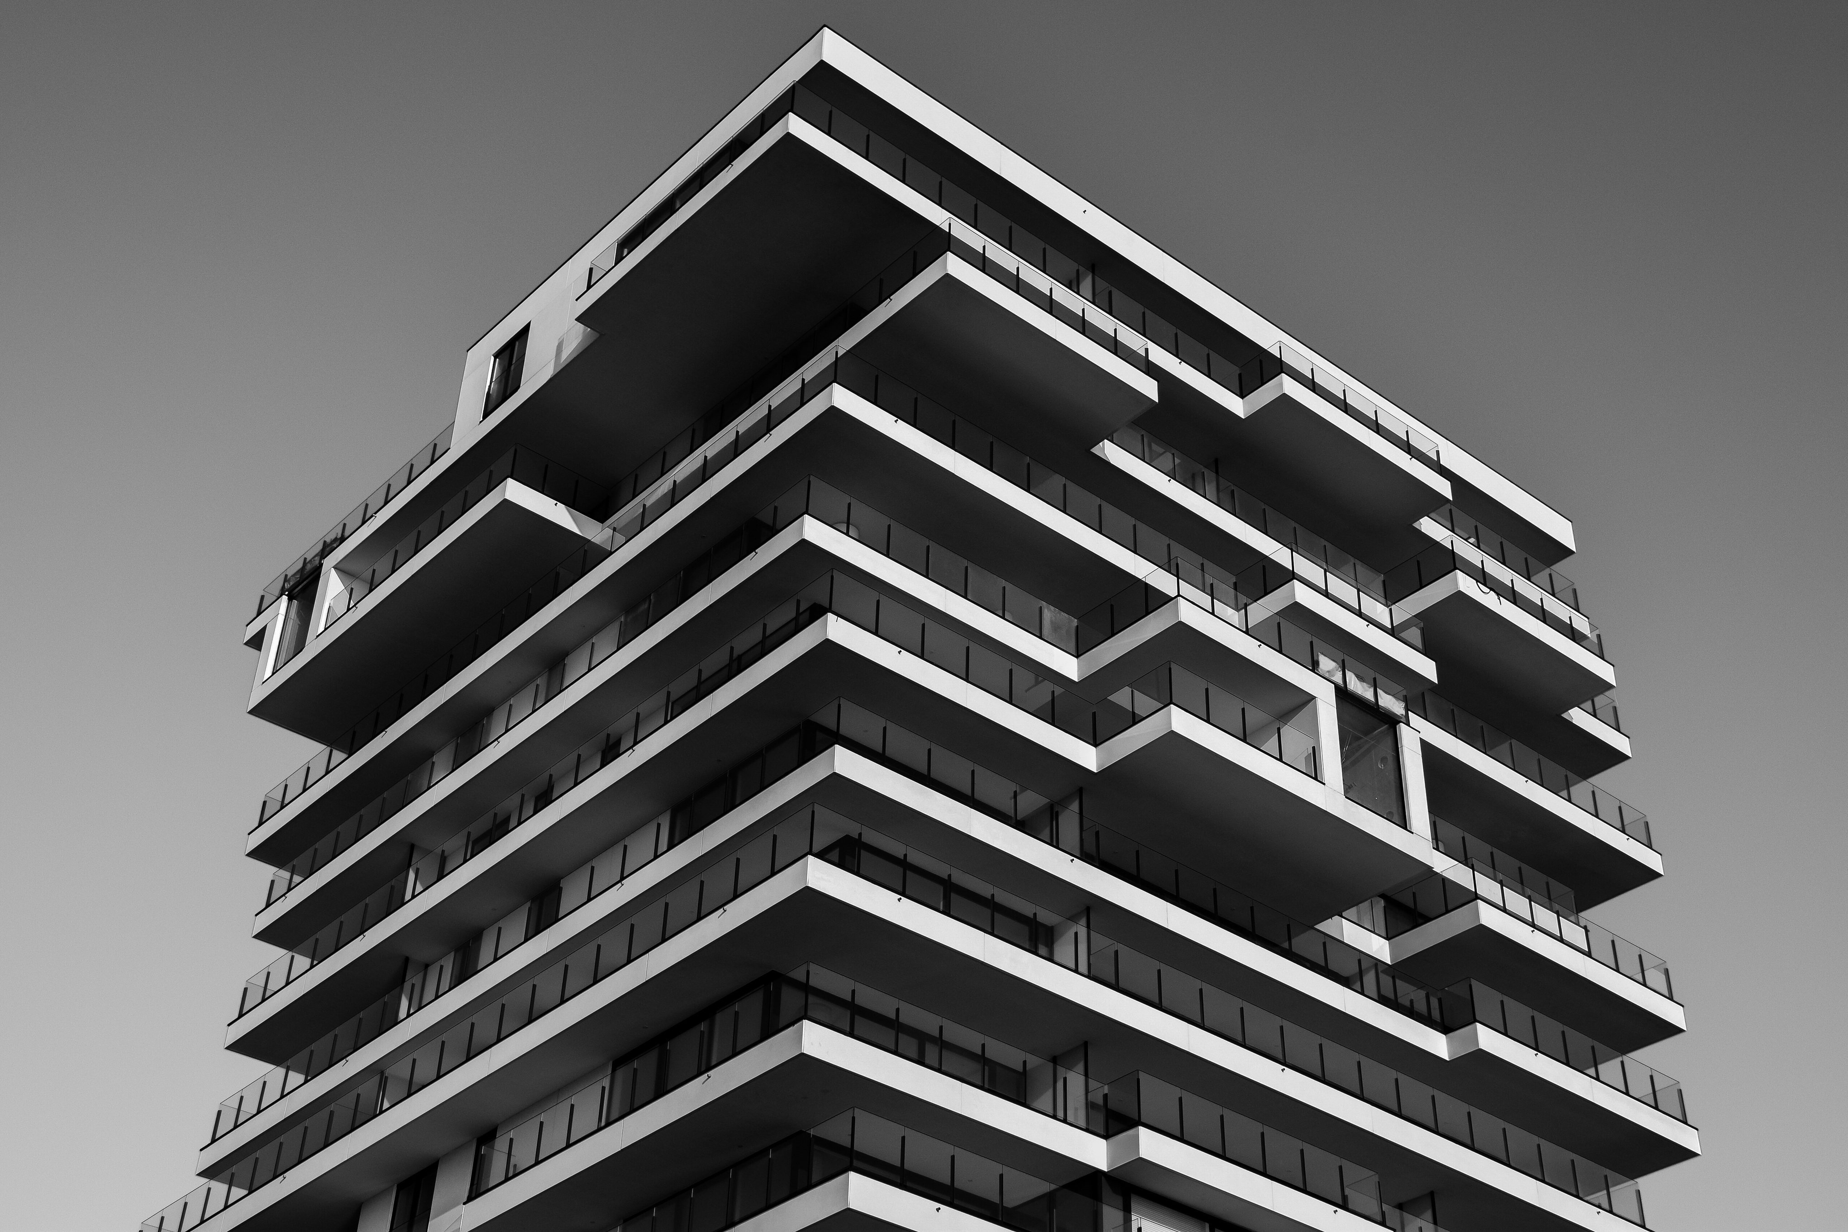

MN 4023 - Individual Assignment
FERROCEMENT WALL PANELS
FOR CONSTRUCTION
Group Members
210016R - Abhirami T.
210070B - Bibulewela P.A.C.
210381E - Mayoorathan K.
210494D - Premakumara H.P.C.
210640A- Themiya K.L.

Slide 2
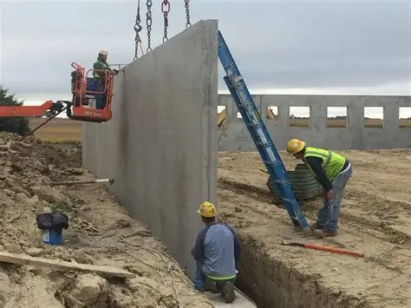
Introduction
  Product:
  Prefabricated ferrocement wall panel made of a cement–sand mortar reinforced with wire mesh, suitable for modular walls in toilets, tanks, and housing units.
  Existing Issues:
  Current prototypes at NERDC face cracking during lifting/handling and excessive self-weight, making transport and installation difficult.
  Final Goal:
  To create an optimized, durable, and sustainable wall panel - reducing weight, preventing cracks.
2
Notes:
Goal: Evaluate if ferrocement panel can safely handle its own weight during lifting and use.

Slide 3
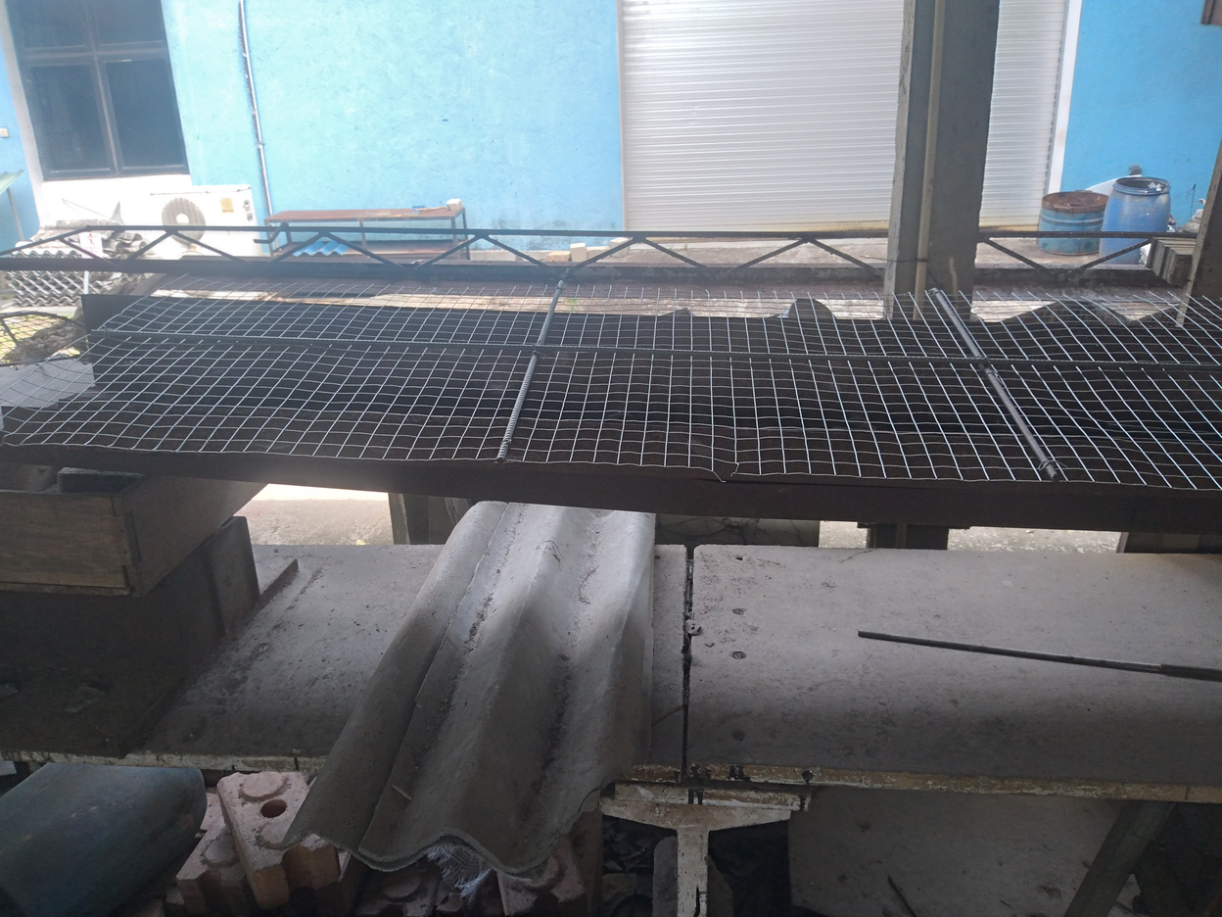
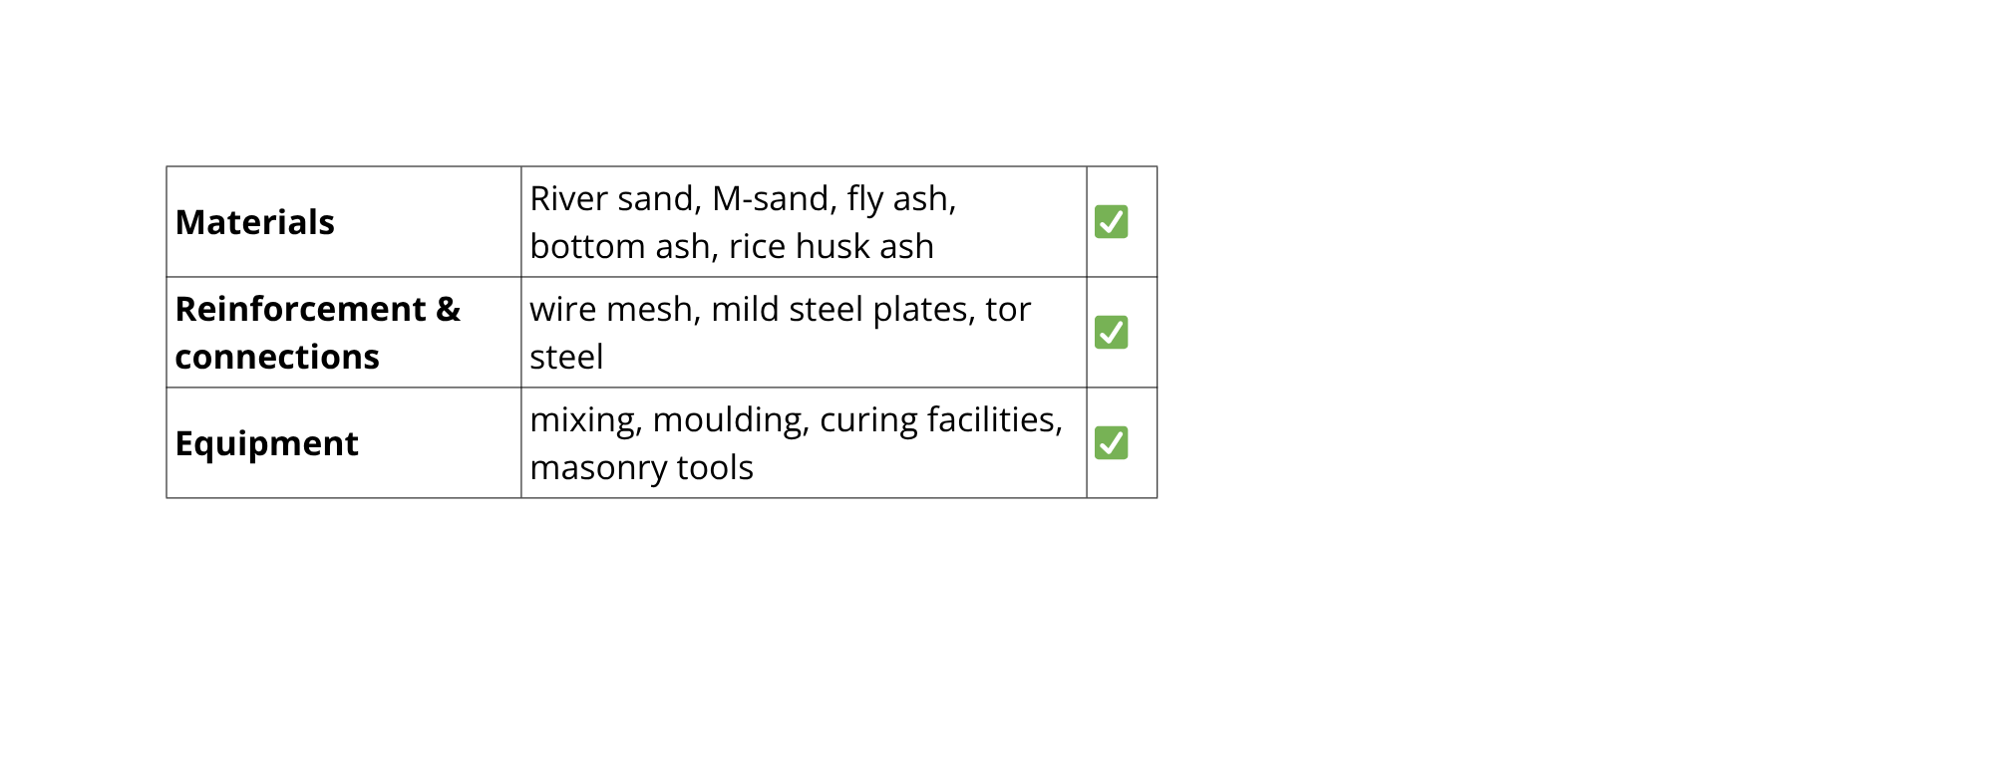
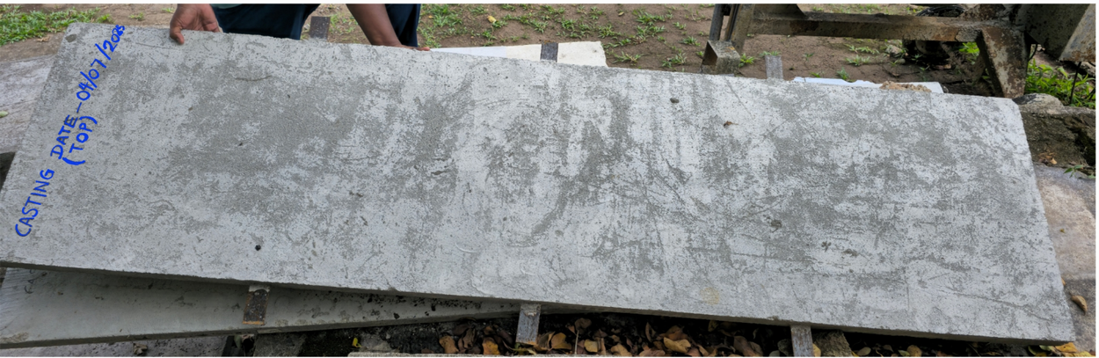
TECHNICAL FEASIBILITY
Resources
1. Reinforcement layout
Method
Expertise
  COMSOL linear-elastic static analysis
  simply supported at short edges
  load = self-weight.
  Institutes: NERDC, UoM
  Human capability
  Technology transfer
2.Cured panels
3
Notes:
* Goal: Evaluate if ferrocement panel can safely handle its own weight during lifting and use.
* Simulation confirms the current panel is at its tensile limit
* Adopting a lightweight hollow or sandwich design makes the technology feasible and durable.
* Panel used in simulation:
2440 × 600 × 40 mm (Base line)
1:1.91 mix (w/c = 0.28)
Density = 2200 kg/m³
E = 20 GPa
ν = 0.20

Slide 4
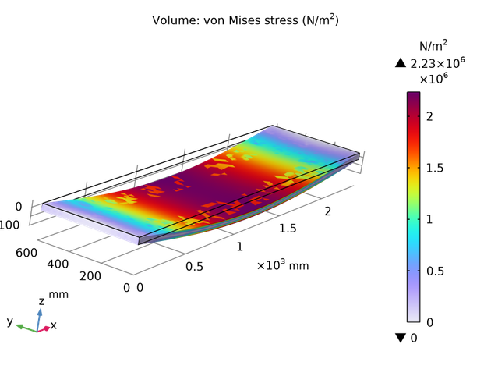
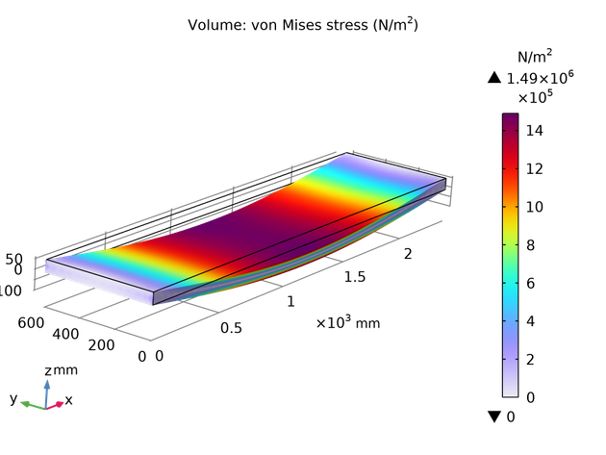
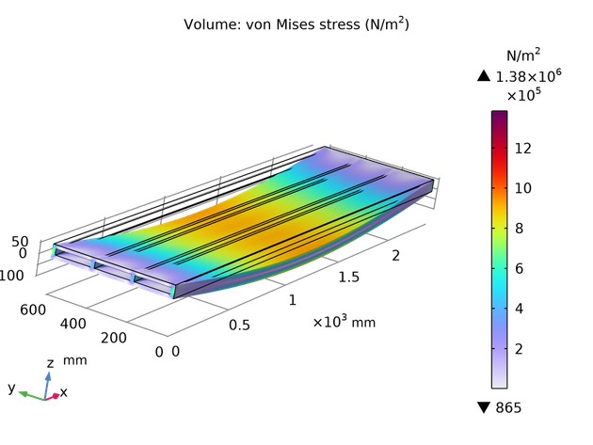

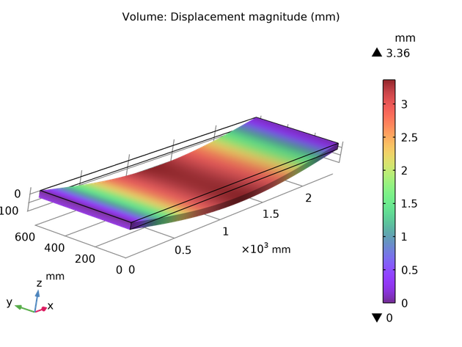
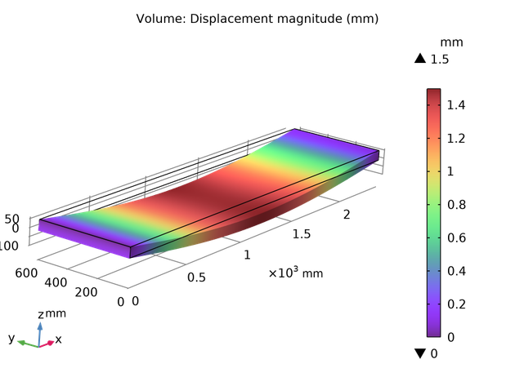
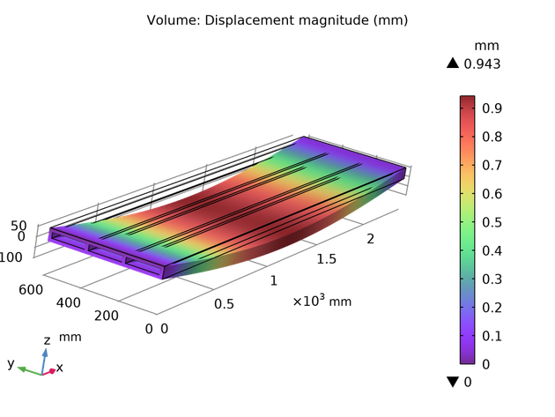
FE Analysis
a) 40 mm panel (solid)
b) 60 mm panel (solid)
c) 60 mm 3-core panel
4

Slide 5
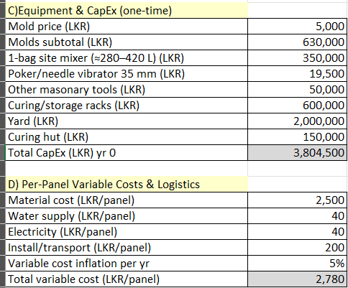
Financial Analysis
Cash Outflows
  Capital Expenditure
  Operational and Maintenance Costs
  Tax
  Total Cost per panel ⁓ 4200 LKR
Cash Inflows
  Panel Sales
  Salvage Value
  Selling Price of a panel = 7000 LKR
5
Notes:
Goal: Evaluate if ferrocement panel can safely handle its own weight during lifting and use.

Slide 6
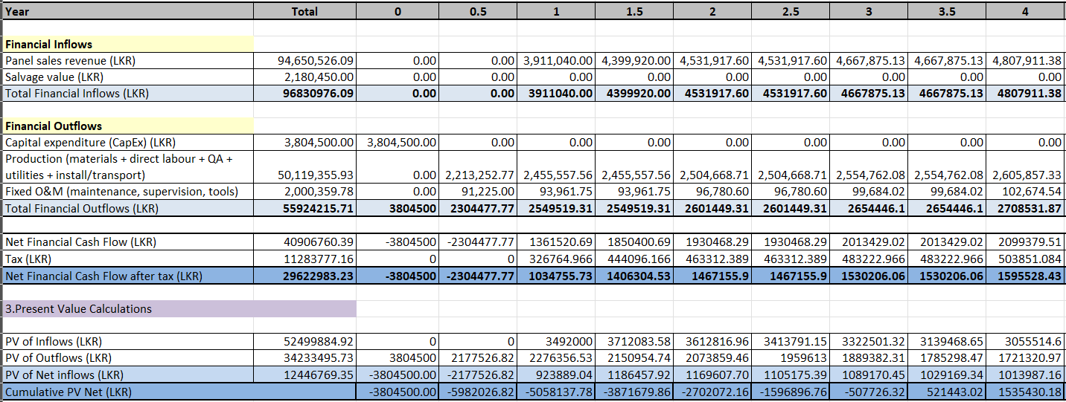
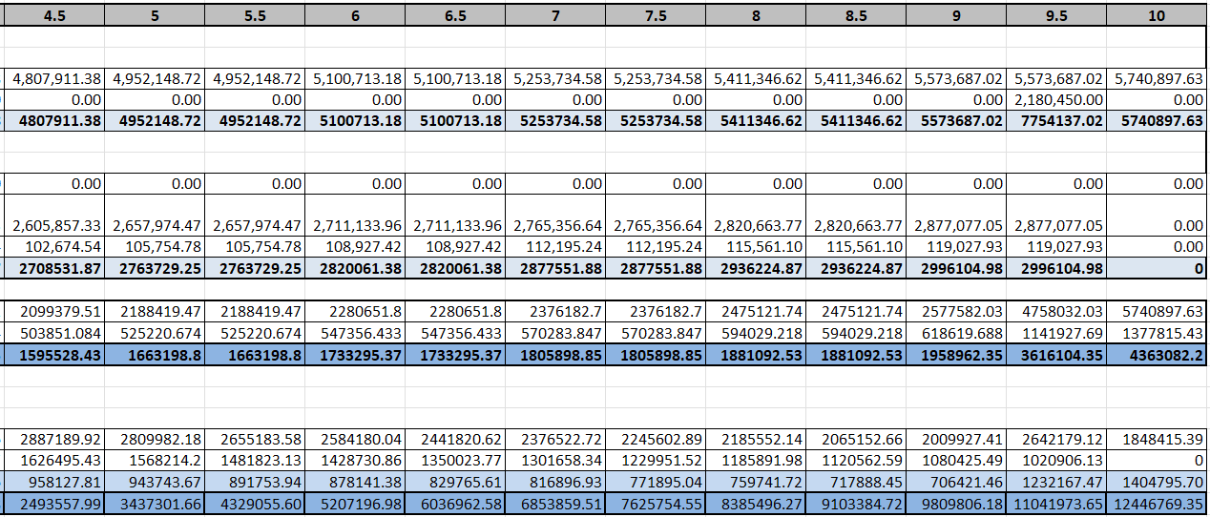
Performance Indicators
  NPV: 12.45 LKR mn ✅
  IRR: 26.36% ✅
  BCR: 1.204 ✅
  Disc. PBP: 3.25 ✅
6
Notes:
Goal: Evaluate if ferrocement panel can safely handle its own weight during lifting and use.

Slide 7
Economical Analysis
Costs
Benefits
  Capital Expenditure
  Materials & Labour
  Operation & Maintenance
  Environmental Management
  Panel Sales
  Employment
  Environmental Benefits
  Time Saving
  Salvage Value
Performance Indicators
  NPV: 30.1 LKR mn ✅
  IRR: 37.4% ✅
  BCR: 1.8792 ✅
  Disc. PBP: 1.83 ✅
7
Notes:
Goal: Evaluate if ferrocement panel can safely handle its own weight during lifting and use.

Slide 8
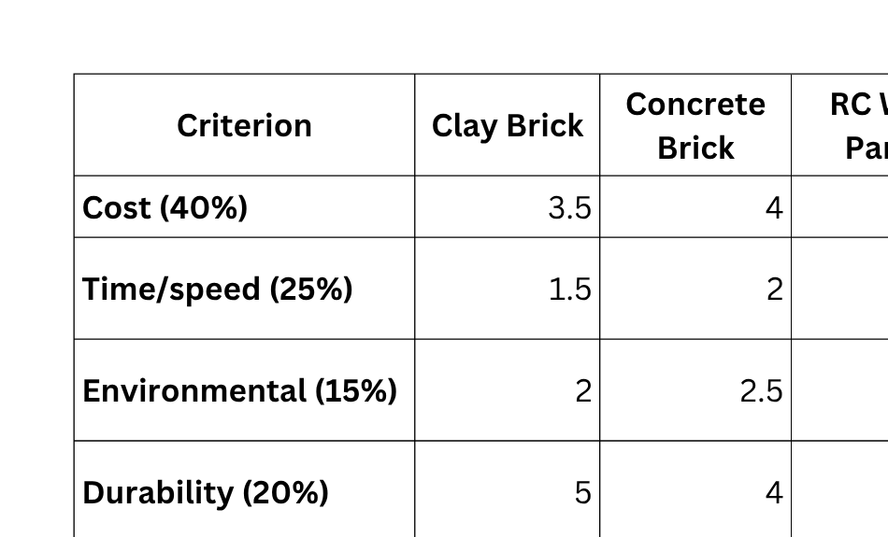
Multi Criteria Analysis
8
Notes:
Positive Impacts
Employment diversification: new skilled jobs in panel casting, curing, and installation.
Reskilling opportunities: traditional masons can be trained for prefab assembly and quality control.
Affordable housing: faster, low-cost walls support social housing and disaster-relief construction.
Community uplift: local manufacturing units create regional income sources and small-scale enterprises.
Cleaner and safer sites: reduced dust, noise, and waste compared to block masonry.
Time efficiency: faster completion improves housing availability and living standards.
Potential Negative / Adverse Impacts
Labor displacement: fewer on-site masonry jobs, risking unemployment among traditional workers.
Cultural resistance: reluctance to trust or adopt non-traditional materials.
Skill gap: short-term shortage of trained workers for panel production and installation.
Quality inconsistency risk: poor training or supervision can cause defects and harm perception.
Urban–rural imbalance: prefab production may centralize in cities, limiting rural employment gains.
End-of-life waste: damaged panels need recycling systems to avoid dumping.

Slide 9
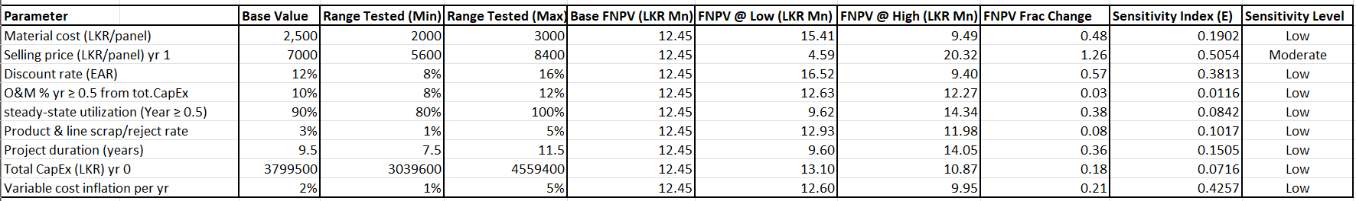
Sensitivity Analysis
Main Factors
  Selling Price
  Material Cost
  Discount Rate
9
Notes:
Positive Impacts
Employment diversification: new skilled jobs in panel casting, curing, and installation.
Reskilling opportunities: traditional masons can be trained for prefab assembly and quality control.
Affordable housing: faster, low-cost walls support social housing and disaster-relief construction.
Community uplift: local manufacturing units create regional income sources and small-scale enterprises.
Cleaner and safer sites: reduced dust, noise, and waste compared to block masonry.
Time efficiency: faster completion improves housing availability and living standards.
Potential Negative / Adverse Impacts
Labor displacement: fewer on-site masonry jobs, risking unemployment among traditional workers.
Cultural resistance: reluctance to trust or adopt non-traditional materials.
Skill gap: short-term shortage of trained workers for panel production and installation.
Quality inconsistency risk: poor training or supervision can cause defects and harm perception.
Urban–rural imbalance: prefab production may centralize in cities, limiting rural employment gains.
End-of-life waste: damaged panels need recycling systems to avoid dumping.

Slide 10
Environmental Analysis
Benefits
  Lower resource consumption
  Reduced embodied energy
  Less on-site waste
  Reusing waste
  Less noisy
Drawbacks
  Cement footprint
  Mesh corrosion waste
  Transport emissions
  End-of-life recycling challenge
  Water use in curing
10
Notes:
Positive Impacts (🟢)
Lower resource consumption: thin mortar sections use significantly less cement and sand.
Reduced embodied energy: no kiln firing (unlike clay bricks); lower CO₂ emissions.
Less on-site waste: prefabrication minimizes spillage and rework.
Recyclable materials: GI mesh and cementitious waste can be reused.
Durability: long service life reduces replacement frequency and lifecycle emissions.
Lightweight structure: lowers foundation material use and transportation fuel.
Negative Impacts (🔴)
Cement footprint: production of OPC still contributes CO₂ unless blended or green cement is used.
Mesh corrosion waste: improper disposal of rusted steel mesh can cause contamination.
Transport emissions: prefab delivery over long distances increases fuel use.
End-of-life recycling challenge: separating mortar and mesh requires energy or new processes.
Water use in curing: may be high unless closed-loop curing or steam curing adopted.
Takeaway:
Ferrocement panels are environmentally favorable compared to conventional masonry, with further gains achievable through green cement, recycled sand, and optimized curing.

Slide 11
Social Analysis
Benefits
  Employment diversification
  Reskilling opportunities
  Affordable housing
  Community uplift
  Cleaner and safer sites
  Time efficiency
Drawbacks
  Labor displacement
  Cultural resistance
  Skill gap
  Quality inconsistency risk
  Urban–rural imbalance
  End-of-life waste
11
Notes:
Positive Impacts
Employment diversification: new skilled jobs in panel casting, curing, and installation.
Reskilling opportunities: traditional masons can be trained for prefab assembly and quality control.
Affordable housing: faster, low-cost walls support social housing and disaster-relief construction.
Community uplift: local manufacturing units create regional income sources and small-scale enterprises.
Cleaner and safer sites: reduced dust, noise, and waste compared to block masonry.
Time efficiency: faster completion improves housing availability and living standards.
Potential Negative / Adverse Impacts
Labor displacement: fewer on-site masonry jobs, risking unemployment among traditional workers.
Cultural resistance: reluctance to trust or adopt non-traditional materials.
Skill gap: short-term shortage of trained workers for panel production and installation.
Quality inconsistency risk: poor training or supervision can cause defects and harm perception.
Urban–rural imbalance: prefab production may centralize in cities, limiting rural employment gains.
End-of-life waste: damaged panels need recycling systems to avoid dumping.

Slide 12
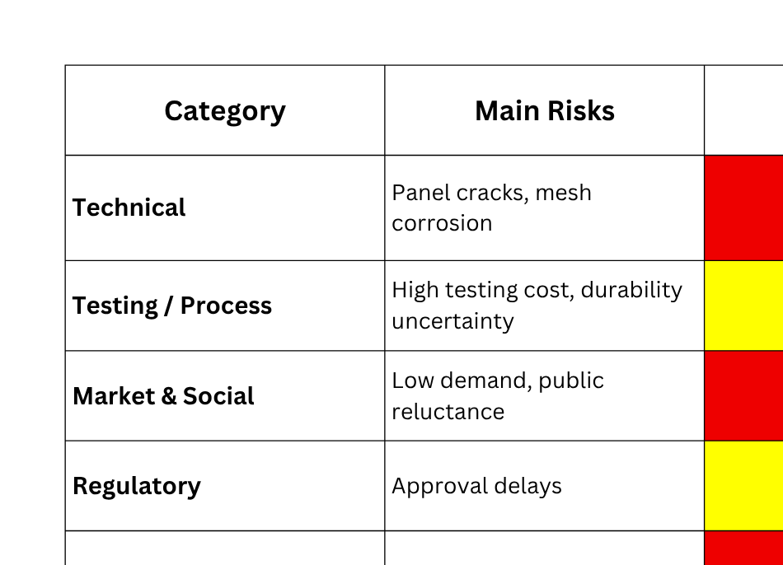
Risk Assessment
12

Slide 13
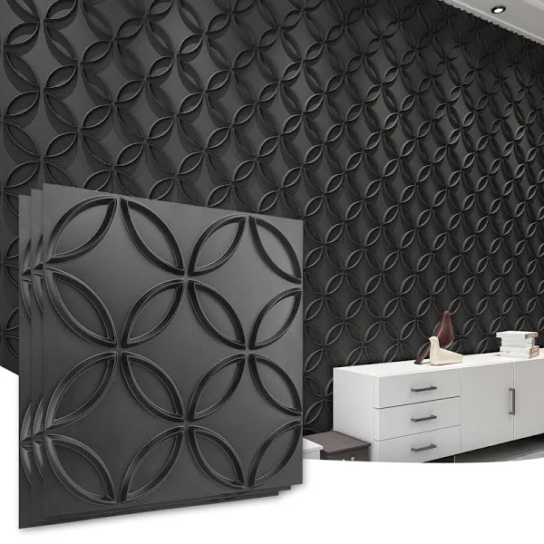


Final Recommendation
  The ferrocement wall panel development project is technically sound, financially viable, and economically beneficial.
  It reduces cost, time, and CO₂ emissions while creating local employment.
  Recommended for implementation and scale-up under NERDC–UoM collaboration.
13
Notes:
Positive Impacts (🟢)
Lower resource consumption: thin mortar sections use significantly less cement and sand.
Reduced embodied energy: no kiln firing (unlike clay bricks); lower CO₂ emissions.
Less on-site waste: prefabrication minimizes spillage and rework.
Recyclable materials: GI mesh and cementitious waste can be reused.
Durability: long service life reduces replacement frequency and lifecycle emissions.
Lightweight structure: lowers foundation material use and transportation fuel.
Negative Impacts (🔴)
Cement footprint: production of OPC still contributes CO₂ unless blended or green cement is used.
Mesh corrosion waste: improper disposal of rusted steel mesh can cause contamination.
Transport emissions: prefab delivery over long distances increases fuel use.
End-of-life recycling challenge: separating mortar and mesh requires energy or new processes.
Water use in curing: may be high unless closed-loop curing or steam curing adopted.
Takeaway:
Ferrocement panels are environmentally favorable compared to conventional masonry, with further gains achievable through green cement, recycled sand, and optimized curing.

Slide 14

THANK YOU

